Slide 1
Transient Atmospheric Circulation Response to An Instantaneous Doubling of Carbon Dioxide
GloDecH Meeting LDEO
Jan-13-2011
Yutian Wu
Department of Applied Physics and Applied Mathematics
Columbia University
Supervised by: Drs. Mingfang Ting, Richard Seager and Mark Cane
In Collaboration with Drs. Naomi Naik and Tiffany Shaw
Thanks to Prof. Lorenzo Polvani

Slide 2
Atmospheric General Circulation Response to Global Warming
Weakening of the Walker Circulation
(e.g., Held and Soden 2006; Vecchi and Soden 2007)
Expansion of the Hadley Cell
(e.g., Lu et al. 2007)
Poleward shift of the tropospheric zonal jets
(e.g., Kushner et al. 2001; Chen and Held 2007)
Poleward shift of the midlatitude storm tracks
(Yin 2005)
Rise in tropopause height
(e.g., Kushner et al. 2001; Lorenz and DeWeaver 2007)

Slide 3
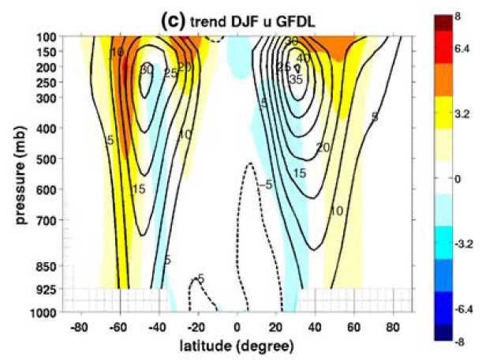
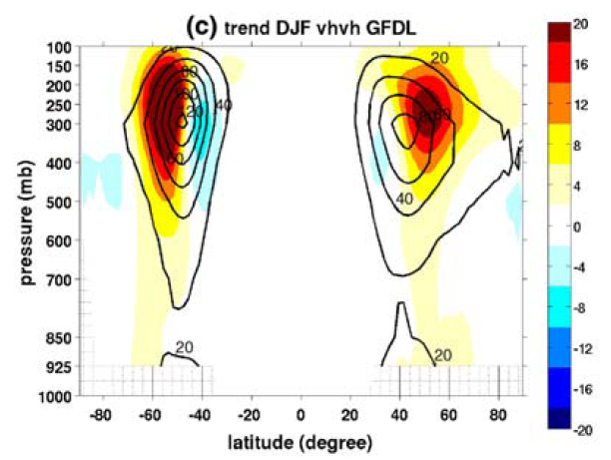
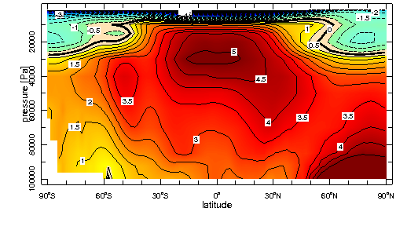
DJF U
Connection between Midlatitude Storm Tracks and Mean State Thermal Structure
GFDL CM2.1 Coupled Climate Model
DJF U & vhvh (bandpass filtered)
Colors: 21c minus 20c
Contours: 20c climatology
Poleward and Upward Shift and Intensification
DJF vhvh
dT/dlat ? midlatitude storm activity v’v’
DJF T
Wu et al. 2010 Clim. Dyn.

Slide 4
Issues to Be Addressed
What causes the broad warming in the middle and upper troposphere?
What causes the poleward shift and intensification of midlatitude jet stream and storm tracks?
What is the step-by-step response in atmospheric general circulation?
What are the dynamical mechanisms?

Slide 5
Atmospheric Circulation Response to An Instantaneous Doubling of Carbon Dioxide
Proposed mechanisms for the poleward shift of the midlatitude jet streams and storm tracks
Lu et al. 2008; Chen and Held 2007 – accelerated eddy phase speed
Lorenz and DeWeaver 2007 – raised tropopause height
Lu et al. 2007 – rising tropospheric static stability
Kidston et al. 2011 – increasing eddy length scale
Center on broad tropical upper tropospheric warming
Q: why not El Nino-like? Broad longwave radiative heating due to CO2 and H2O?
Notes:
Chen and Held 2007 – accelerated eddy phase speed shifts the subtropical breaking region and thus the transient momentum flux and surface westerlies poleward in the Southern Hemisphere

Slide 6
Lu et al. 2008
Response of the zonal mean atmospheric circulation to El Nino versus global warming
Notes:
Unlike for El Nino, …
no much mechanism is clear for global warming.

Slide 7
Atmospheric Circulation Response to An Instantaneous Doubling of Carbon Dioxide
Proposed mechanisms for the poleward shift of the midlatitude jet streams and storm tracks
Chen and Held 2007 – accelerated eddy phase speed
Lorenz and DeWeaver 2007 – raised tropopause height
Lu et al. 2007 – rising tropospheric static stability
Kidston et al. 2010 – increasing eddy length scale
Center on broad tropical upper tropospheric warming
Q: why not El Nino-like? Broad longwave radiative heating due to CO2 and H2O?
Previous modeling studies on climate response to increased atmospheric carbon dioxide
E.g., Hansen et al. 1984; Manabe et al. 1990; Rind et al. 1990; Meehl and Washington 1996; Shindell et al. 2001; IPCC AR4 2007
Focus on time-mean equilibrium response
Q: Dynamics? Transient response…
Notes:
Chen and Held 2007 – accelerated eddy phase speed shifts the subtropical breaking region and thus the transient momentum flux and surface westerlies poleward in the Southern Hemisphere

Slide 8

Our Approach –
Atmospheric Transient Response to An Instantaneous 2CO2
Model
NCAR Community Atmospheric Model (CAM) Version 3
Modified physics and dynamics (Collins et al. 2006)
CCSM3 - CAM3 T85L26 fully coupled model - IPCC AR4
We use CAM3 T42L26 (model top 2.917mb) coupled to a slab ocean model (q-flux) and a thermodynamic sea ice model
specified heat exchange and ocean heat transport
ocean mixed layer depths
surface energy fluxes
Notes:
h - observed climatological monthly mean ocean mixed layer depths
Q_flx - ocean heat transport, calculated from the surface energy fluxes obtained from a control run with prescribed ice and sea surface temperatures (SSTs)

Slide 9
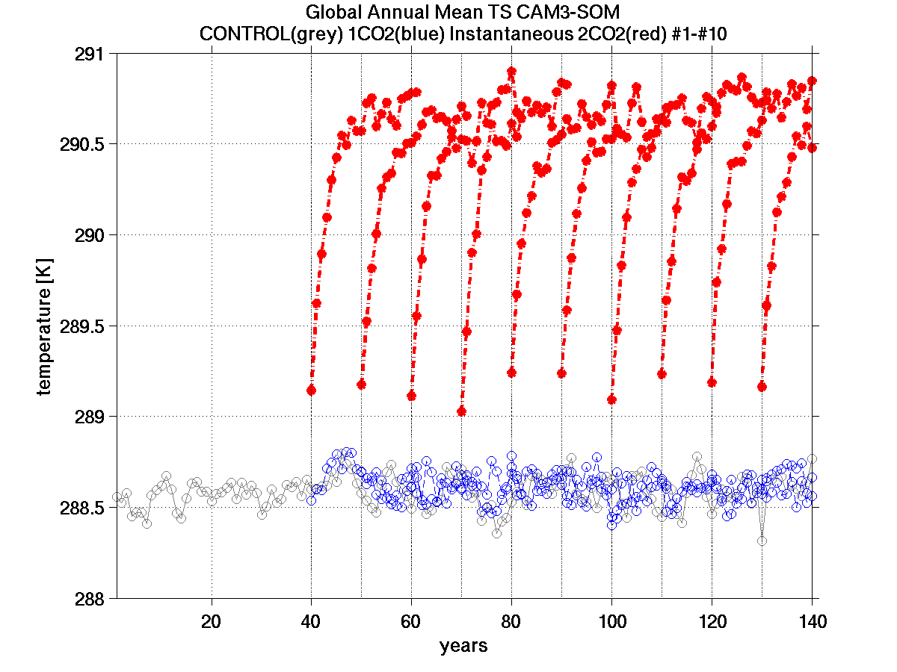
Experiment Design (CAM3-SOM)
140-year CONTROL RUN (355ppmv CO2): equilibrium after 40 years
22-year ANOMALOUS RUN
Jan-01-yr as initial condition with 1CO2 (355ppmv) and 2CO2 (710 ppmv) separately
100 pairs of ensemble runs
Some daily variables saved for 1st and 2nd year
2CO2
CONTROL
1CO2

Slide 10
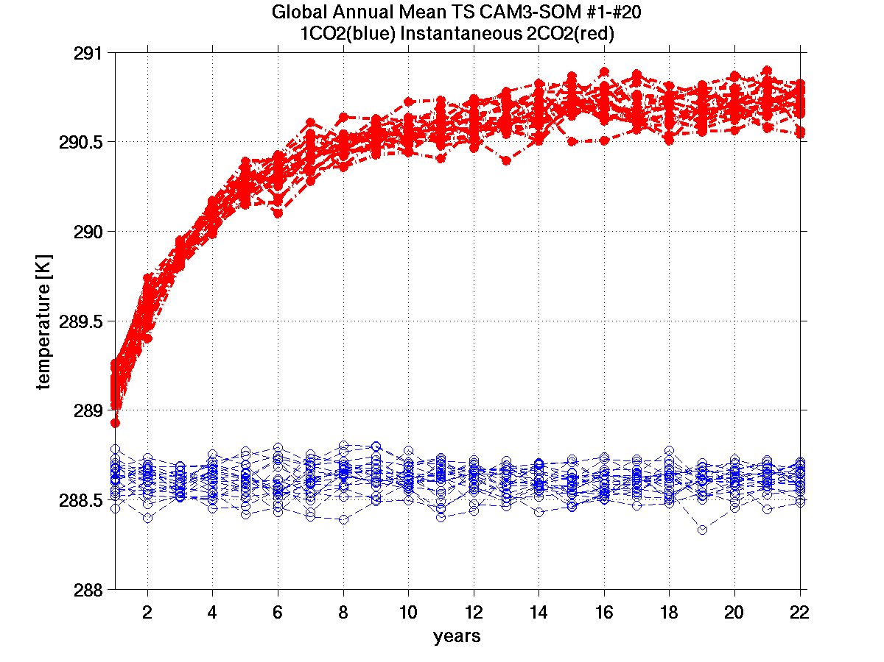
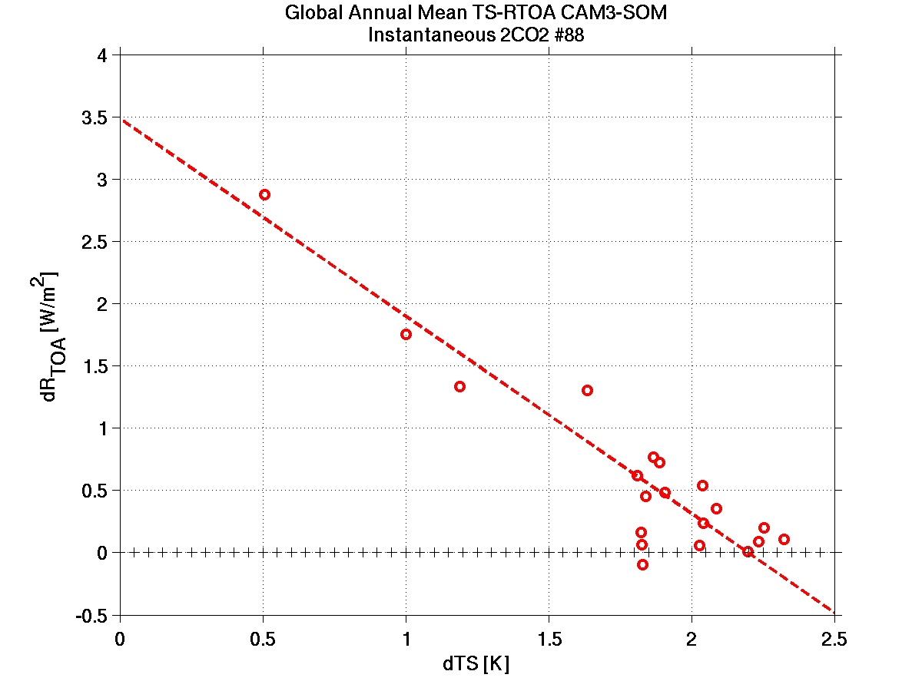
TS - 2CO2 SOM asymptotes towards equilibrium in 20 years
RTOA v.s. TS
2CO2 forcing F_{2x} = 3.48 W/m2
2CO2
1CO2

Slide 11
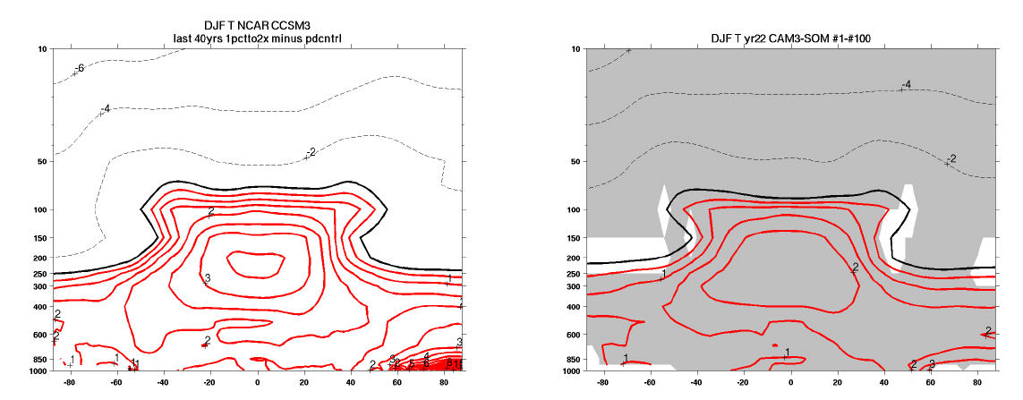
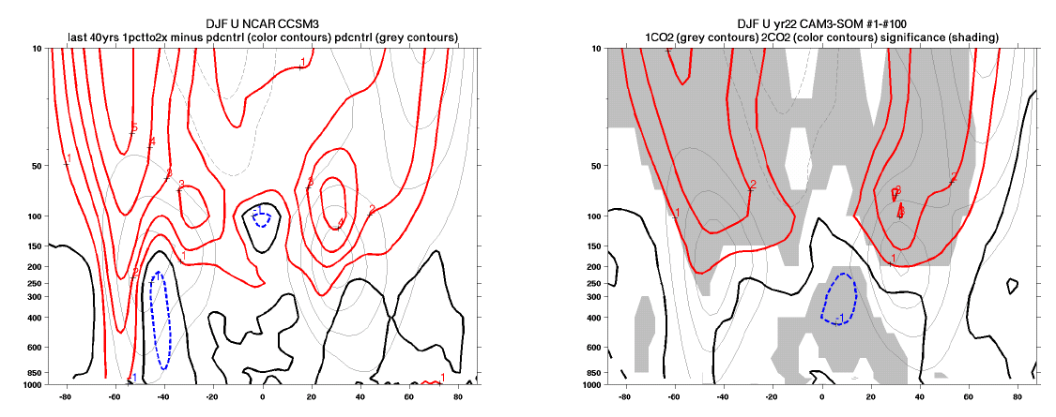
CAM3-SOM 2CO2 yr22 100 runs equilibrium response
NCAR CCSM3
1pctto2x minus pdcntrl
Color Contours: Trend
Grey Contours: Climatology
Shading: significance (95%)
DJF T (CI: 0.5 K)
DJF U (CI: 1 m/s)
Notes:
Forcing setting, model horizontal resolution, slab ocean model

Slide 12
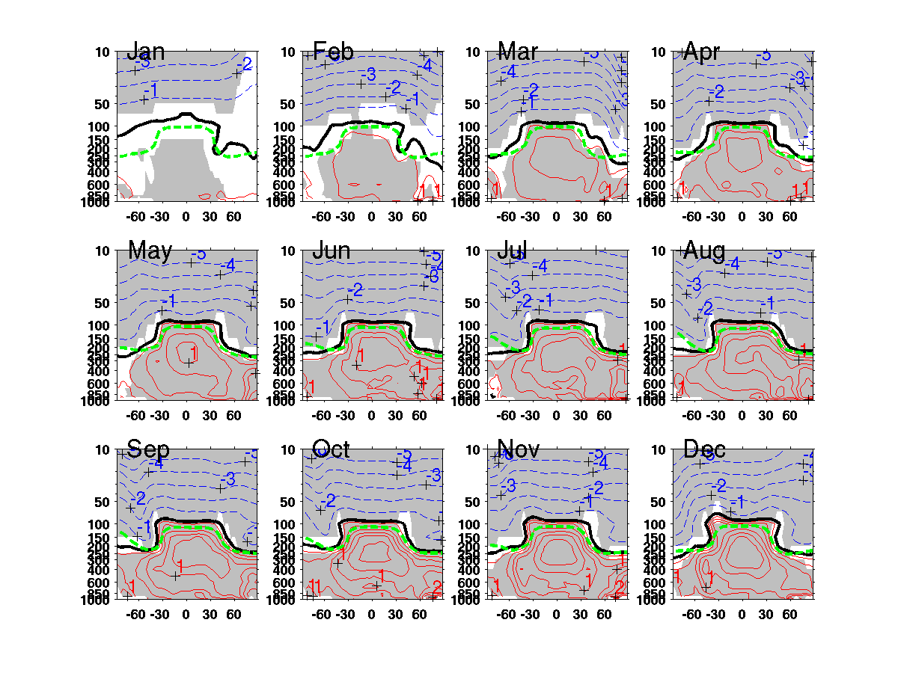
Red – Positive Blue – Negative Thick Black – Zero
Green – 1CO2 Tropopause Height
Shading: significance (95%)
CAM3-SOM 2CO2 yr1
T (CI: 0.25 K)
100 runs
Fast response in stratosphere
Tropospheric warming expands in Feb. / Mar.
Pressure
(mb)
Latitude
Notes:
Rapid radiation and thermal response in the stratosphere (weeks) and SST warming and tropical convection takes time
Tropical upper tropospheric warming broadens from Feb. Mar. and Apr.

Slide 13
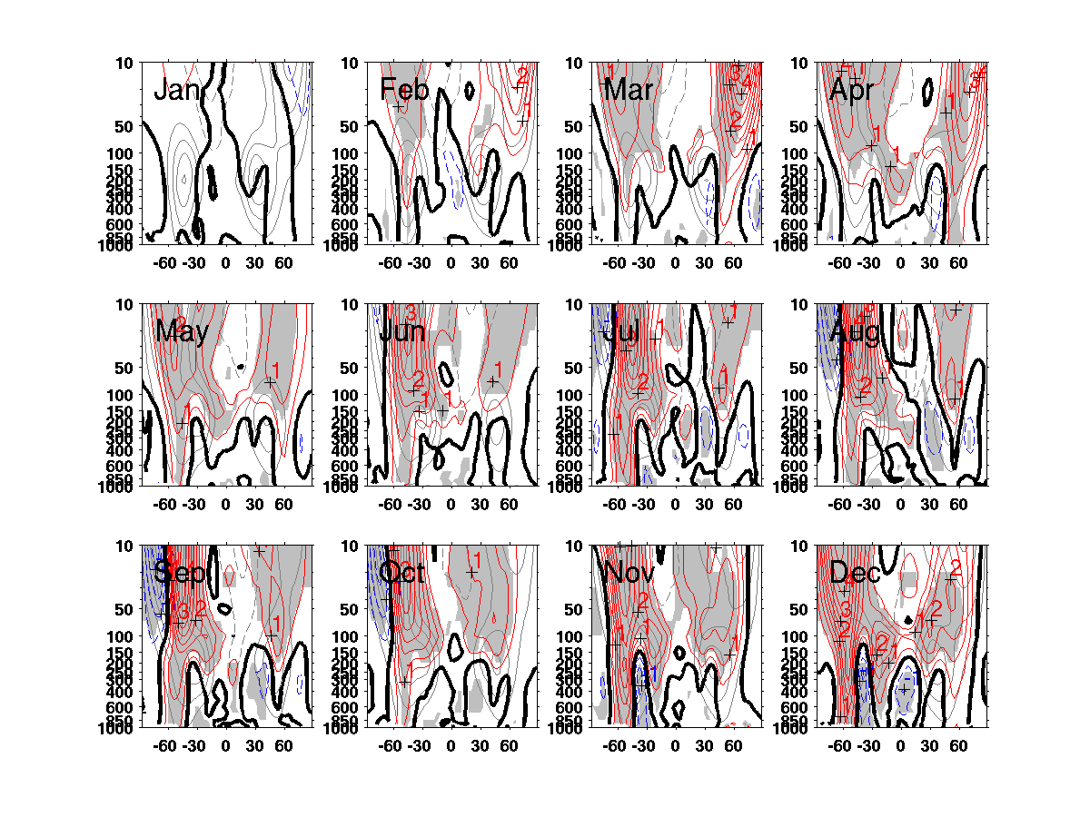
CAM3-SOM 2CO2 yr1 100 runs
U (CI: 0.5 m/s)
Intensified subpolar westerlies in stratosphere
U shift in troposphere in Mar. NH
Color Contours: Trend
Grey Contours: Climatology
Shading: significance (95%)
Pressure
(mb)
Latitude
Notes:
Intensified subpolar westerlies in the stratosphere

Slide 14
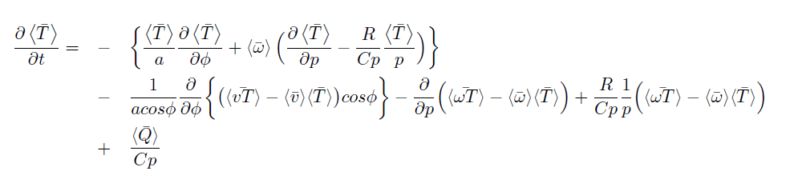
Zonal mean temperature equation:
Mean meridional circulation (MMC)
Eddies (transient & stationary)
Diabatic heating
Q = DTCOND + QRS + QRL + DTH + DTV
Notations: \overline – time average
Brackets \langle – zonal average

Slide 15
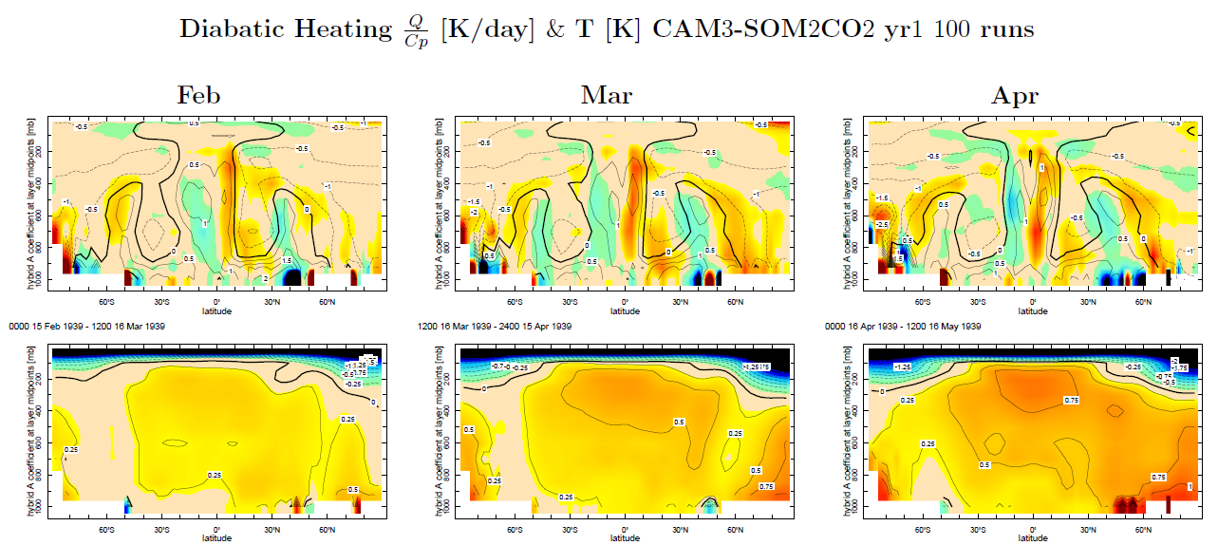
Q/Cp
Colors – 2CO2 – 1CO2
Contours – 1CO2
T
Colors / Contours:
2CO2 – 1CO2
Thermodynamics Diagnostics:
Middle and upper tropospheric warming expansion
Not diabatic heating (reduction in DTCOND)
Dynamically-driven & Adiabatic warming due to anomalous descending motion

Slide 16

Eddy-driven vertical motion (Seager et al. 2003):
Transient eddy momentum flux
Notations: \overline – time average
Brackets \langle – zonal average

Slide 17
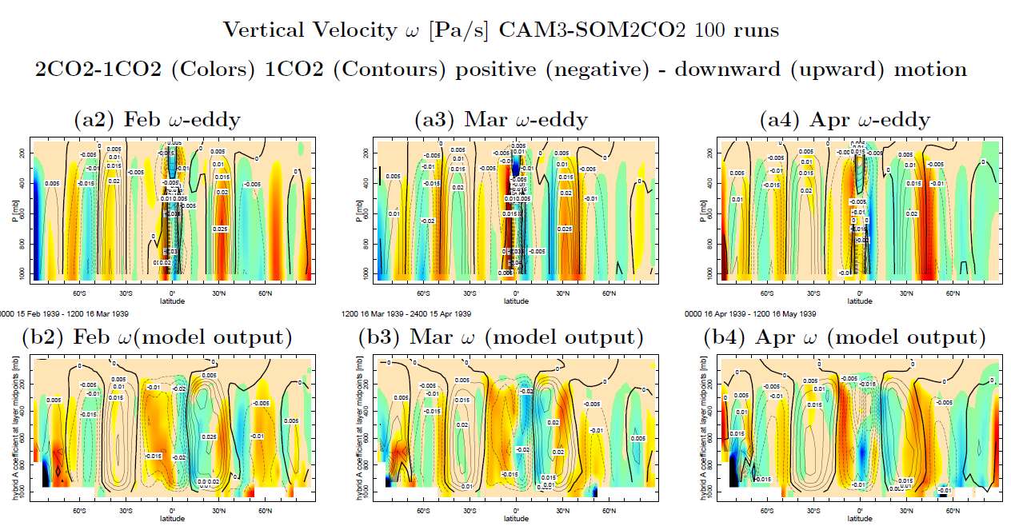
Eddy-driven vertical motion (Seager et al. 2003)
Colors – Change
Contours - Climatology
eddy-driven vertical motion
Anomalous Descending Motion
Induced by transient eddies (intensified transient eddy momentum flux)
Cause adiabatic warming in the upper and middle troposphere
Intensified transient momentum flux convergence leads to the initial broad upper tropospheric warming!

Slide 18
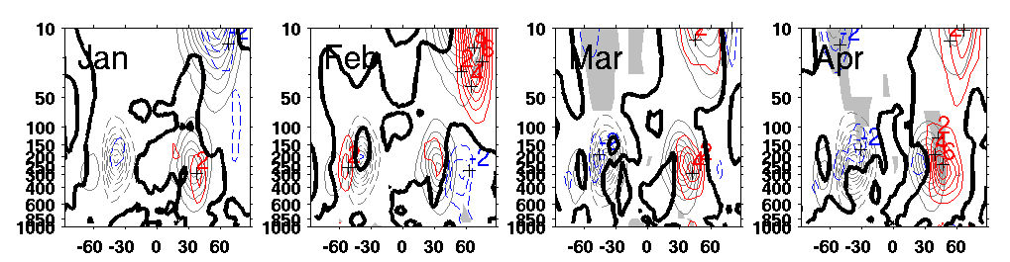
CAM3-SOM 2CO2 yr1 100 runs
transient momentum flux
UpVp (CI: 1 m2/s2)
Color Contours: Trend
Grey Contours: Climatology
Shading: significance (95%)

Slide 19
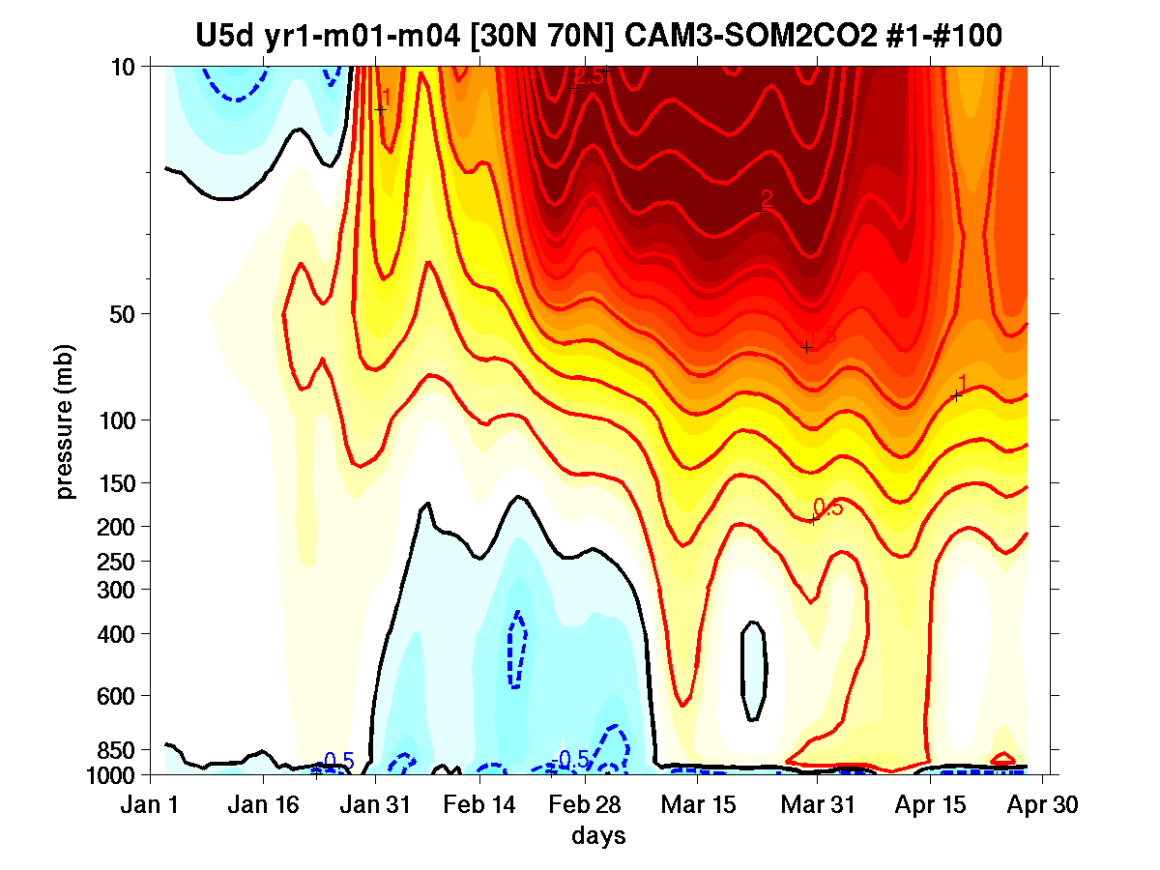
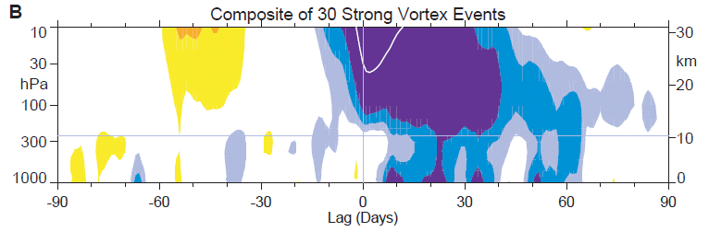
CAM3-SOM 2CO2
U 5d runningAverage [30N 70N] (CI: 0.25 m/s)
Northern Annular Mode (NAM)
(Baldwin and Dunkerton 2001 Sci.)
Initial mean flow acceleration in stratosphere
Response descending downward from stratosphere to troposphere in months (100 days)
Downward Propagation of NAM
A delay in tropospheric response & last more than 60 days

Slide 20
Possible Causal Sequence in Inducing Midlatitude Tropospheric Circulation under Global Warming
2CO2
CO2 Radiative Effects in the Stratosphere
Reduce vertical static stability, increase APE (e.g., Rind et al. 1990, 1998)
Altered mean flow distribution and planetary wave propagation waveguide (e.g., Harnik and Lindzen 2001)
More Planetary Waves Propagating Upward into the Stratosphere (k = 1, 2,3)
Wave-mean flow interaction
Deflected planetary wave propagation
Increased Eddy Forcing (Stationary)
Mean Flow Acceleration in the Stratosphere
Downward Influence
“Downward Control” theory
Wave-mean flow interaction
Tropospheric Eddy Feedbacks
(e.g., Haynes et al. 1991; Kushner and Polvani 2004; Wittman et al. 2007)
Poleward Displacement of Midlatitude Tropospheric Jets &
Broad Tropical Upper Tropospheric Warming

Slide 21
Conclusions
Confirmed the poleward and upward shift and intensification of the midlatitude storm tracks simulated in coupled GCMs
Intensified energy transport by the storm tracks is, to a large extent, attributed to increasing correlation coefficient between eddy motion and eddy energy
Intensified storm track energy transport is strongly connected to the intensified energy imbalance in the atmosphere
(Initial) Broad tropical upper tropospheric warming is dynamically-driven and the coupling between stratosphere and troposphere is important in regulating the tropospheric circulation response

